Slide 1

F-CRAIG
By
Subham Agrawal
Vamsi Krishna Pamidi Tazeem Khan

Slide 2
1 —
Background

Slide 3
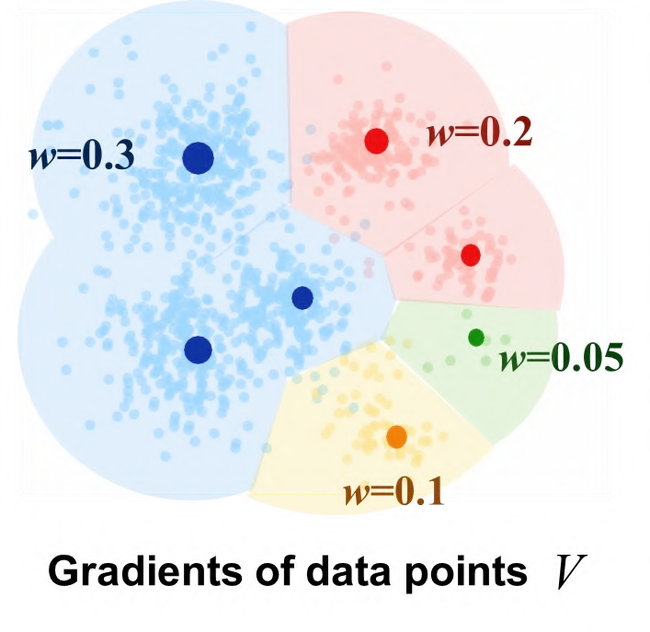
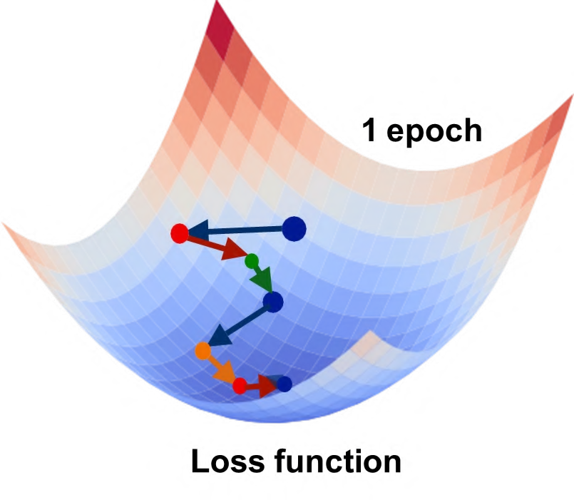
CRAIG
The aim is to select a weighted subset that closely estimates the full gradient
It uses Greedy Algorithm to ﬁnd the set of exemplars S from Dataset.
The limitation of this approach is that when the Dataset gets extremely large, the time to calculate the Similarity Matrix will increase signiﬁcantly due to the calculation time being O(N²) and Space required to store this information will be huge as well.
Floats in similarity matrix of 10,000 Data points - 0.1 Billion
Floats in similarity matrix of 1,000,000 Data points - 1000 Billion

Slide 4
2 —
Approach

Slide 5
FORGETTING EVENTS
Forgetting event is when a data point is misclassiﬁed after begin correctly classiﬁed.
1 1 1 0 0
Forgetting Event
Prediction
Accuracy
-

Slide 6
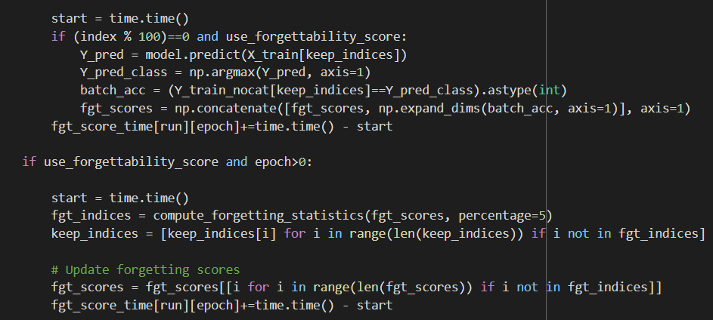
DATA PRUNING
We calculate Forgetting scores after N number of Minibatches for Speedup
Forgetting Scores being stored
Indices to be dropped based on Learnt and Forgetting Events

Slide 7

We send these Pruned data as an input to the CRAIG to find a Representative subset
Subset from CRAIG
NOTE - Subset size is same as CRAIG in the approach.
(40% of the training data)
Pruned Points

Slide 8
3 —
Results

Slide 9
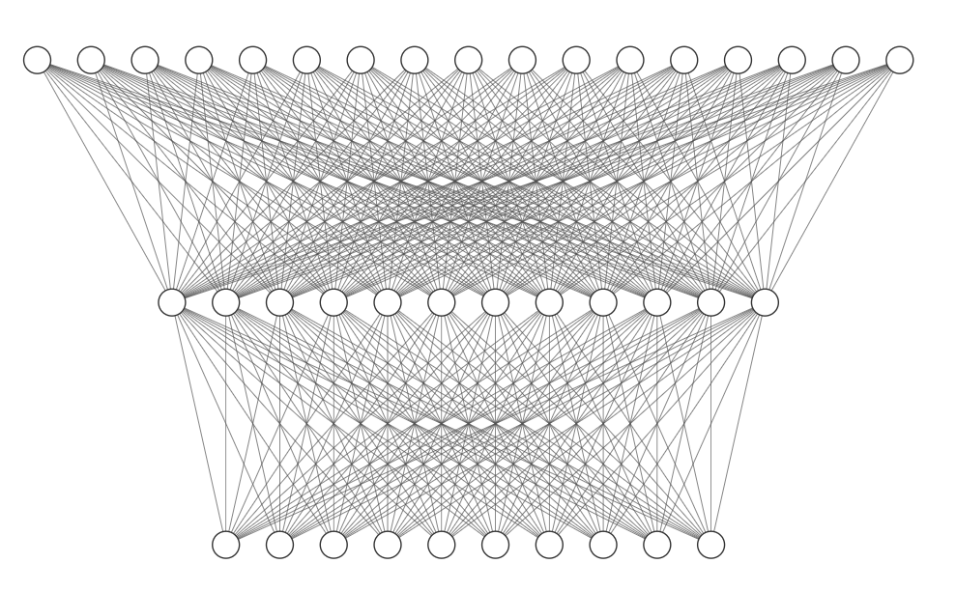
DATA AND MODEL
The Data we have used in our experiments is MNIST with 60,000 images, each of size - 28*28 and 10 classes.
Input Layer - 28*28 = 784
Hidden Layer - 100
Output Layer - 10

Slide 10
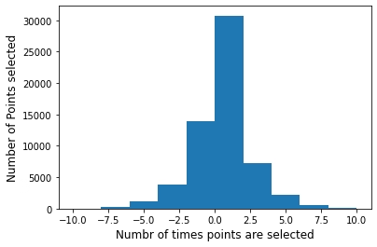
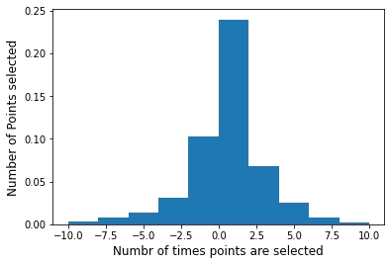
SELECTED POINTS
2 Runs of CRAIG
F-CRAIG vs CRAIG

Slide 11
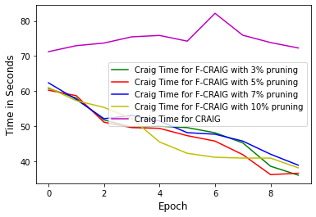
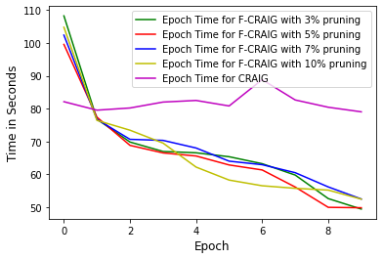
TIME COMPARISONS
Comparing CRAIG vs F-CRAIG with Diﬀerent Pruning %

Slide 12
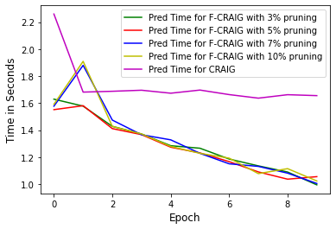
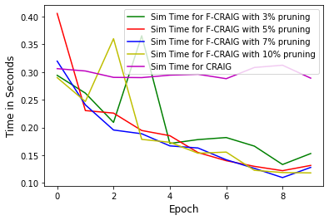
TIME COMPARISONS
Comparing CRAIG vs F-CRAIG with Diﬀerent Pruning %

Slide 13
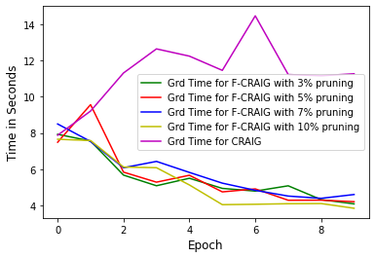
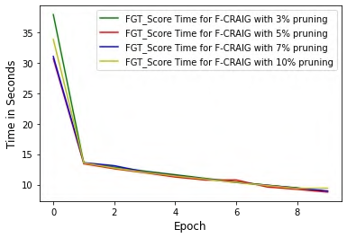
TIME COMPARISONS
Comparing CRAIG vs F-CRAIG with Diﬀerent Pruning %

Slide 14
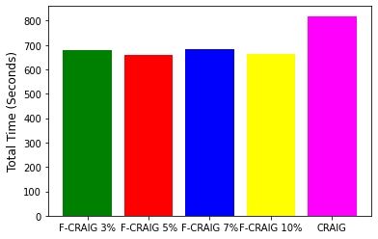
TOTAL TIME
Comparing CRAIG vs F-CRAIG with Diﬀerent Pruning %
For 10 Epochs

Slide 15
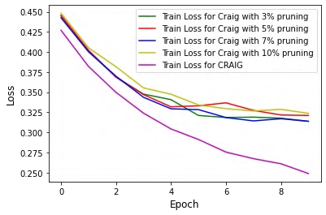
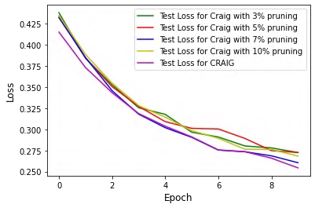
LOSS
Comparing CRAIG vs F-CRAIG with Diﬀerent Pruning %

Slide 16
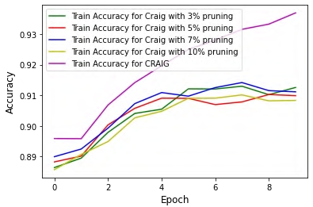
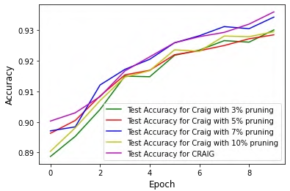
ACCURACY
Comparing CRAIG vs F-CRAIG with Diﬀerent Pruning %

Slide 17
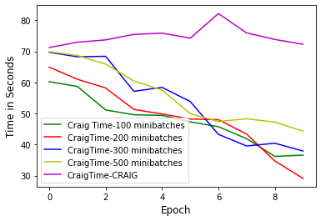
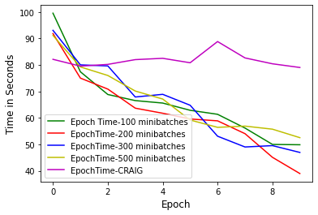
TIME COMPARISON
Comparing CRAIG vs F-CRAIG with Diﬀerent N for Minibatches in Forgetting Score Calculations

Slide 18
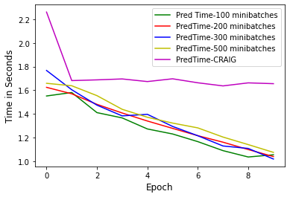
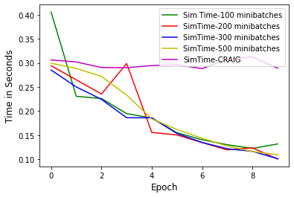
TIME COMPARISON
Comparing CRAIG vs F-CRAIG with Diﬀerent N for Minibatches in Forgetting Score Calculations

Slide 19
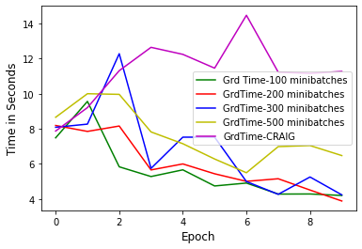
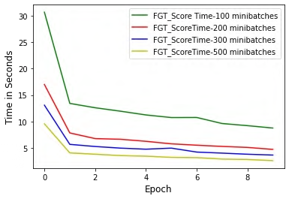
TIME COMPARISON
Comparing CRAIG vs F-CRAIG with Diﬀerent N for Minibatches in Forgetting Score Calculations

Slide 20
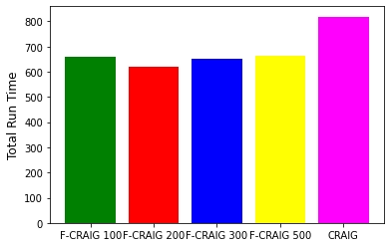
TOTAL TIME
Comparing CRAIG vs F-CRAIG with Diﬀerent N for Minibatches in Forgetting Score Calculations
For 10 Epochs

Slide 21
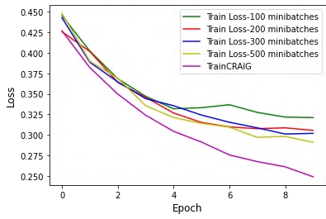
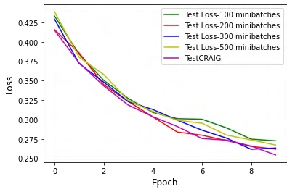
Loss
Comparing CRAIG vs F-CRAIG with Diﬀerent N for Minibatches in Forgetting Score Calculations

Slide 22
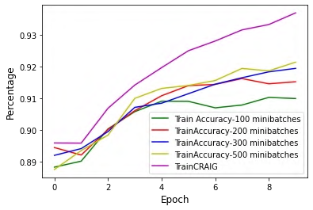
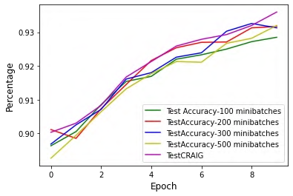
ACCURACY
Comparing CRAIG vs F-CRAIG with Diﬀerent N for Minibatches in Forgetting Score Calculations

Slide 23
4 —
Future Work

Slide 24
Running multiple runs to get statistically significant results
Experimenting F-CRAIG on Larger Datasets and Deep Networks
Reducing the CRAIG subset size with epochs
Dynamic Pruning methodology

Slide 25
References
Baharan Mirzasoleiman, Jeff Bilmes, and Jure Leskovec. Coresets for data-efficient training of machine learning models. arXiv preprint arXiv:1906.01827, 2019
Toneva, M., Sordoni, A., des Combes, R.T., Trischler, A., Bengio, Y., Gordon, G.J. An empirical study of example forgetting during deep neural network learning. In ICLR, 2019.
https://github.com/baharanm/craig
https://github.com/mtoneva/example_forgetting

